Slide 1
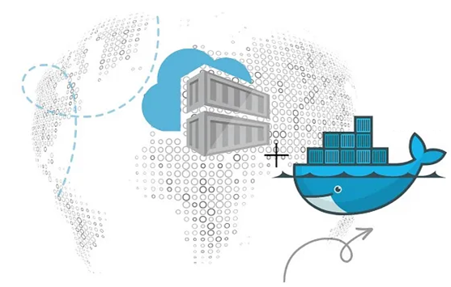
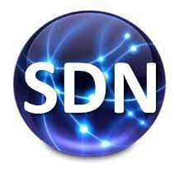
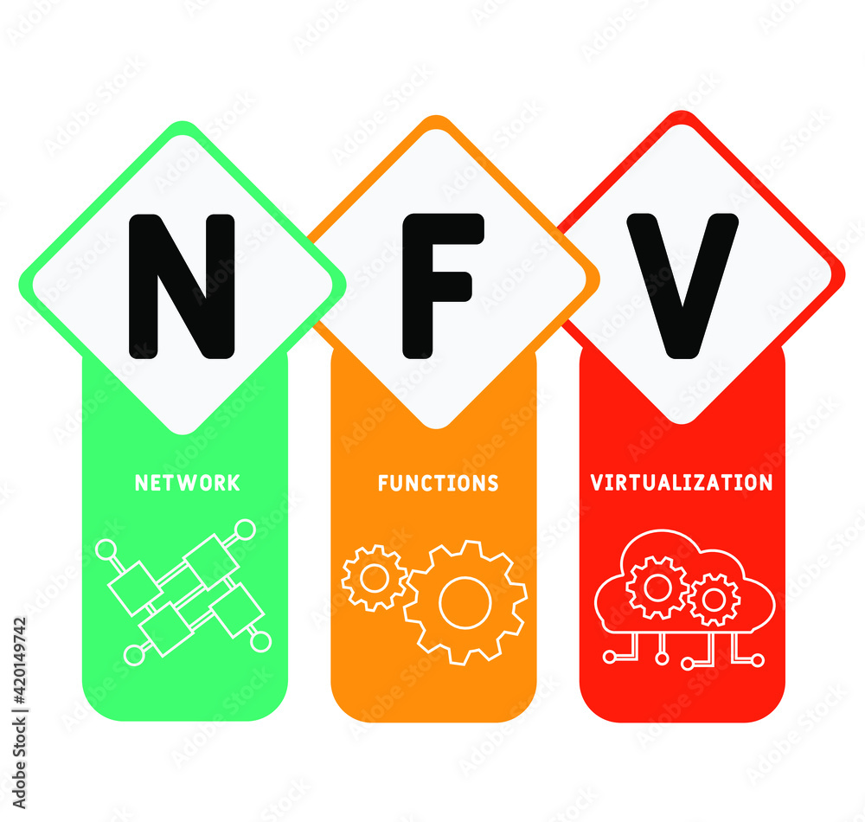
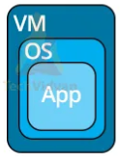


PDS
Computer Vision
Lab_Project_Data_Communication_2026
Data
Communication
@ P. Siagian
Simulation
https://github.com/siagianp
https://www.youtube.com/@AmelOline/videos
https://github.com/amelcharolinesgn2/IoT_simulator-mqtt-NodeRed
https://github.com/amelcharolinesgn2/Cloud-Infrastructures
https://github.com/amelcharolinesgn2/ClouD-Infrastructure-SISKA-2025
https://github.com/amelcharolinesgn2/Gyroscope-Sensor-Data-Accelerometer
Notes:
data communication simulator
https://github.com/yetanalytics/datasim
Quantum Communication Simulator
https://github.com/Slygriyrsk/quantum-communication-simulator
MIL-STD-1553-Simulator
MIL-STD-1553 is a serial communication protocol that is used in spacecrafts for internal communication. A spacecraft consists of various components like main computer, star tracker, fly wheel, temperature sensor, cameras (also called as Remote Terminals) etc. The main computer needs to communicate with all the other peripherals to get the data and send it to ground station for further processing. This internal communication is done by a serial bus called MIL-STD-1553. This repository contains a simulation for this protocol. It can be used to create any space applications by importing the simulator into your code.
MIL-STD-1553 has Bus Controller that orchestrates the transmission and reception of data on the serial bus. It always initiates the communication and commands Remote Terminal for sending or receiving data. Only one node or Remote Terminal can send data on the bus at a given moment when ordered by the Bus Controller. The details of the protocol can be found in MIL-STD-1553 Tutorial and Reference document by Alta dt.
About This Repository:
This repository segregated based on various components that are described in the MIL-STD-1553 standard. Two of the most important components are Bus Controller and Remote Terminals. For a small network, one serial bus can handle up to 31 remote terminals and one bus controller. This repository is divided into two parts. Bus Controller Simulator and Remote Terminal Simulator. Both the components have separate set of functionalities.
Bus Controller Simulator : This simulator is responsible to understand the requirements from the Flight Software or Spacecraft computer and send commands and data to Remote Terminal.
Remote Terminal Simulator : This simulator is responsible for understanding the commands or data comming from the Bus Controller and send status and data based on the requirements sent by the Bus Controller.
How To Use This Simulator
https://github.com/ShubhankarKulkarni/MIL-STD-1553-Simulator
This simulator uses ethernet communication instead of the actual physical communication that is mentioned in the standars. The standard is developed taking harsh and noisy conditions into account. The simulator majorly focuses on data layer of the standard. Based on this, you can either deploy both the simulators on the same machine and test it over the local loopback or you can deploy separate simulators on separate machines in a single subnet or same network.
You can run the following commands to run the simulators
python BC_Simulator.py
python RT_Simulator.py
python Simulator.py
Or you can uncomment a section of code in Simulator.py that creates threads for Bus Controller Simulator and Remote Terminal Simulator and then run the following command
python Simulator.py
Simulator.py only provides an example of how you can use BC and RT simulators. You can replace Simulator.py by any space application that needs to transfer any data using MIL-STD-1553. Apart from that, this whole repository is developed as a module. So, you can simply clone the repository into your application and can import it.
Arikatakur/Network-Transmission-Simulator
https://github.com/Arikatakur/Network-Transmission-Simulator
imulates network data transmission using the Stop-and-Wait protocol with acknowledgment packets. It includes:
Theoretical Calculator: Computes the time required to send a file under ideal conditions.
UDP File Transfer Tools: Sends files over a network using UDP and logs transmission details.
Experimentation Framework: Measures and compares theoretical vs. actual transmission times.
Features
Command-line interface for both theoretical calculations and actual file transmission.
Logs packet transmission details, acknowledgments, and final results.
Javadoc documentation for all classes and methods.
Test cases for robust verification.
Requirements
Java Development Kit (JDK) version 8 or higher.
Two computers on the same network for experimentation.
Tools:
iperf for bandwidth measurement.
Wireshark for packet analysis.
Design of data communication networks using simulation techniques
A Simulator for FANETs Using 5G Vehicle-to-Everything Communications and Named-Data Networking
https://arxiv.org/html/2510.13823v1

Slide 2
Simulator Komunikasi Data
Simulasi Jaringan Skala Besar: Memodelkan jaringan kompleks (WAN, Internet), sering digunakan untuk penelitian performa protokol, routing (perutean), dan manajemen lalu lintas data.
Simulator Protokol (e.g., Wireshark): Menganalisis paket data secara real-time atau dari file tangkapan (capture file), menunjukkan detail protokol lapisan (TCP/IP, UDP, dll.).
Laboratorium Virtual (e.g., CODSIM): Dirancang untuk tujuan pendidikan, memungkinkan eksperimen dengan line coding, modulasi, dan teknik transmisi data digital secara visual.
Simulator Perangkat Keras (Hardware-in-the-Loop): Menggabungkan komponen perangkat keras nyata dengan simulasi perangkat lunak untuk pengujian yang lebih realistis.
Alat & Platform:
NS-3 & OMNeT++: Simulator jaringan open-source populer untuk penelitian dan pendidikan.
Packet Tracer (Cisco): Alat visualisasi dan simulasi jaringan untuk belajar tentang perangkat Cisco dan topologi jaringan.
GNS3: Memungkinkan simulasi perangkat jaringan real-world (router, switch) dalam lingkungan virtual.
Notes:
https://github.com/vpulab/wisemnet

Slide 3
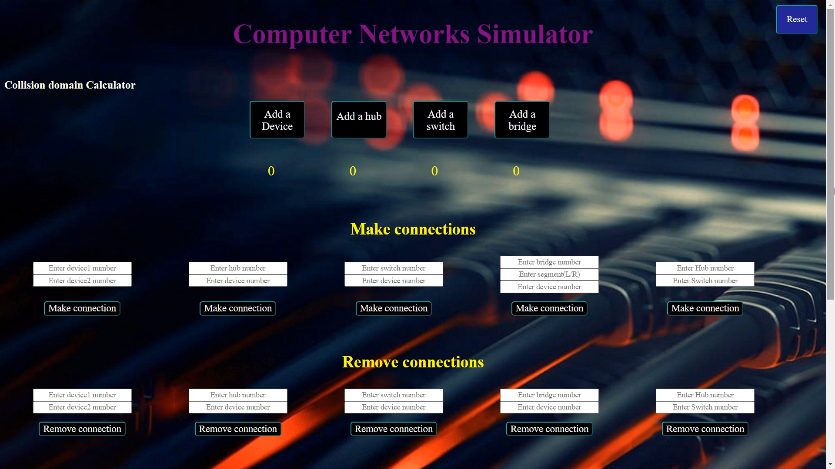
COMPUTER NETWORKING SIMULATOR...
https://github.com/siagianp
https://www.youtube.com/@AmelOline/videos
https://github.com/amelcharolinesgn2/IoT_simulator-mqtt-NodeRed
https://github.com/naiyer-abbas/Networking-Simulator-GUI-
https://github.com/amelcharolinesgn2/Cloud-Infrastructures
https://github.com/amelcharolinesgn2/ClouD-Infrastructure-SISKA-2025
https://github.com/amelcharolinesgn2/Gyroscope-Sensor-Data-Accelerometer
Notes:
https://github.com/Shengyuan-Li/CNN-for-Crack-Detection

Slide 4
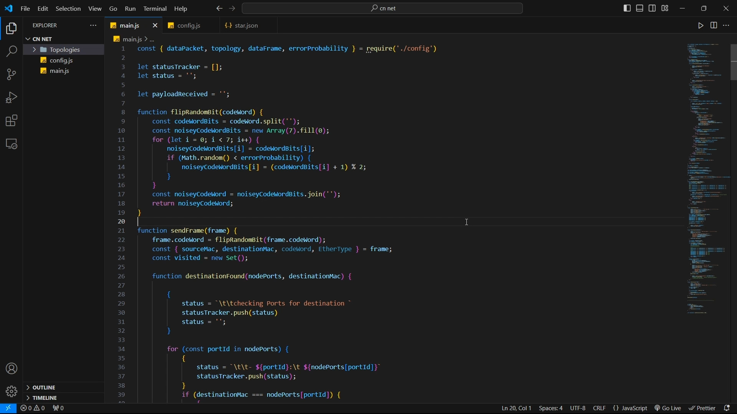
Network Simulator: Physical and Data Link Layer...
https://github.com/siagianp
https://www.youtube.com/@AmelOline/videos
https://github.com/amelcharolinesgn2/IoT_simulator-mqtt-NodeRed
https://github.com/SF404/Network-Simulator
https://github.com/amelcharolinesgn2/Cloud-Infrastructures
https://github.com/amelcharolinesgn2/ClouD-Infrastructure-SISKA-2025
https://github.com/amelcharolinesgn2/Gyroscope-Sensor-Data-Accelerometer
Notes:
https://github.com/Shengyuan-Li/CNN-for-Crack-Detection

Slide 5
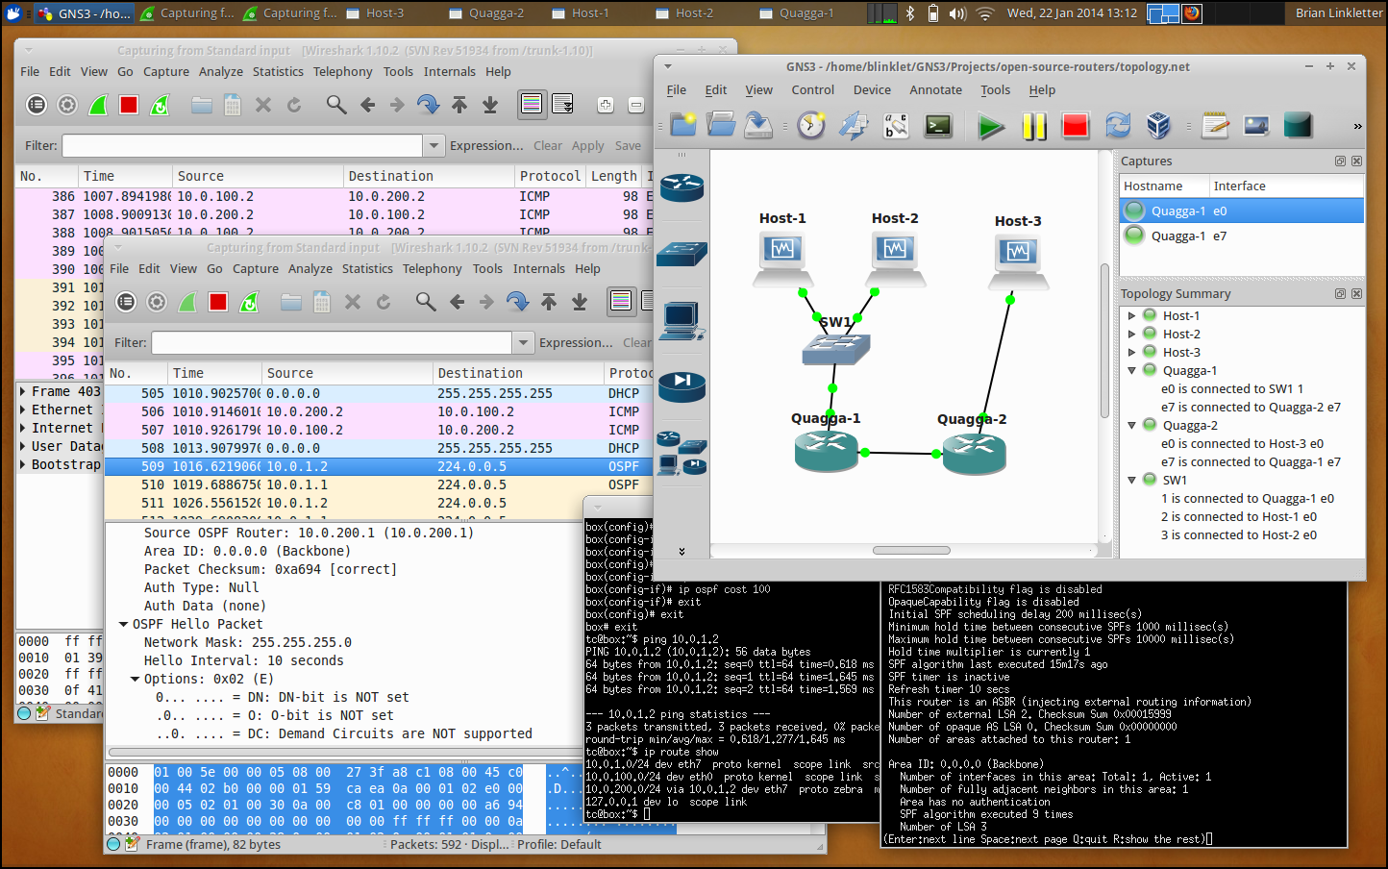
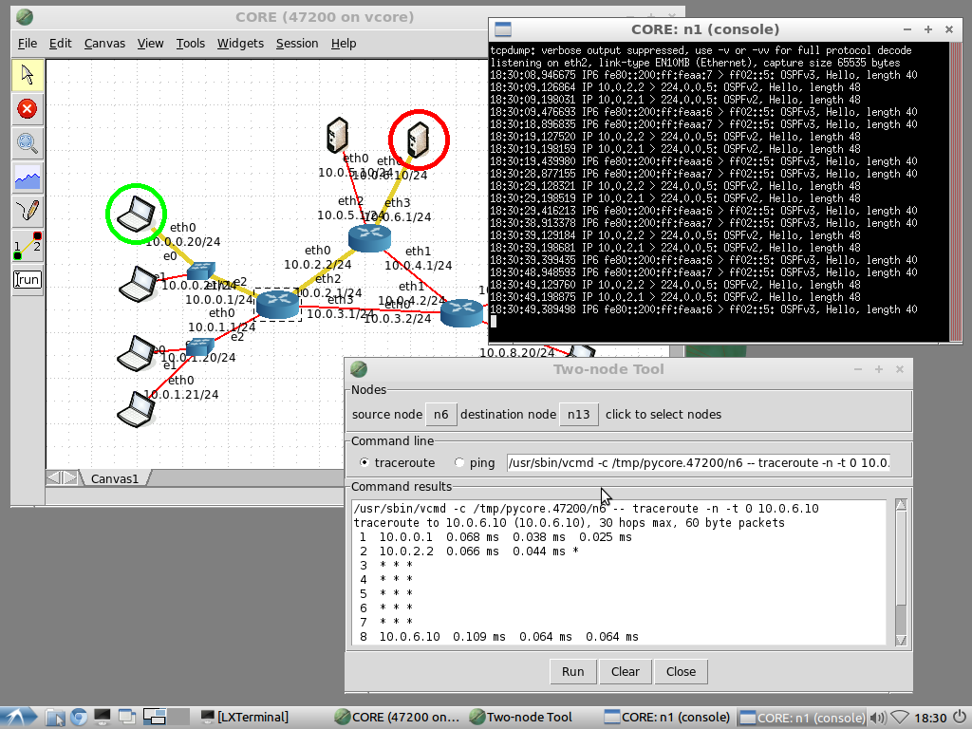
Open-Source Network Simulators...
https://github.com/siagianp
https://www.youtube.com/@AmelOline/videos
https://github.com/amelcharolinesgn2/IoT_simulator-mqtt-NodeRed
https://opensourcenetworksimulators.com/open-source-network-simulators/
https://github.com/amelcharolinesgn2/Cloud-Infrastructures
https://github.com/amelcharolinesgn2/ClouD-Infrastructure-SISKA-2025
https://github.com/amelcharolinesgn2/Gyroscope-Sensor-Data-Accelerometer
Notes:
https://github.com/Shengyuan-Li/CNN-for-Crack-Detection

Slide 6
github data communication simulator
MIL-STD-1553-Simulator https://github.com/ShubhankarKulkarni/MIL-STD-1553-Simulator

Slide 7
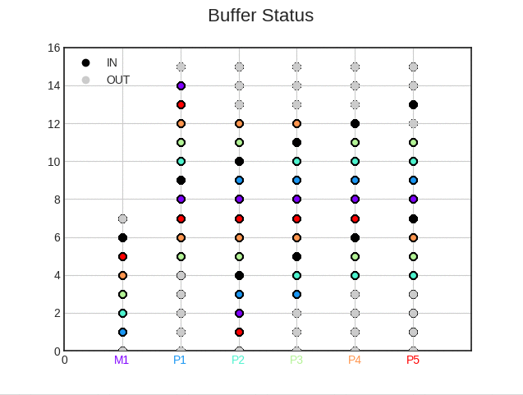
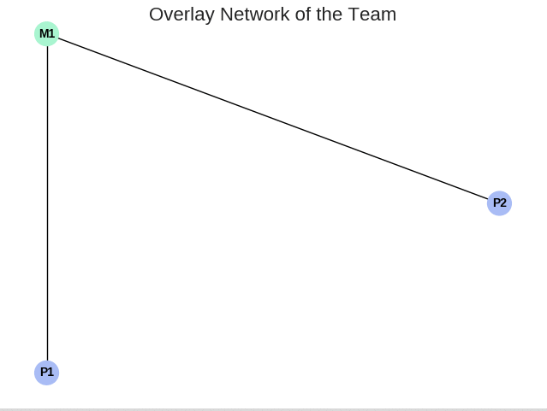
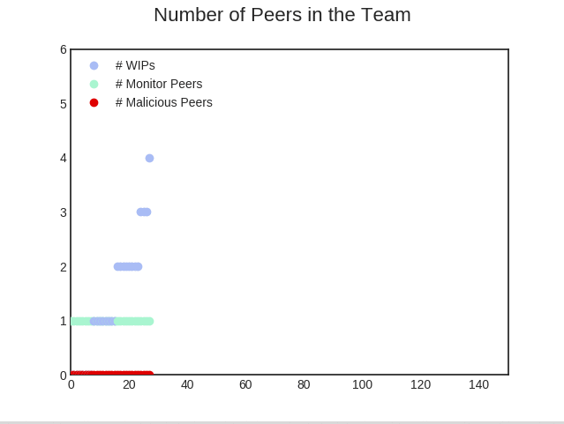
github Network Transmission simulator
P2PSP simulator https://github.com/P2PSP/simulator
https://github.com/Arikatakur/Network-Transmission-Simulator

Slide 8
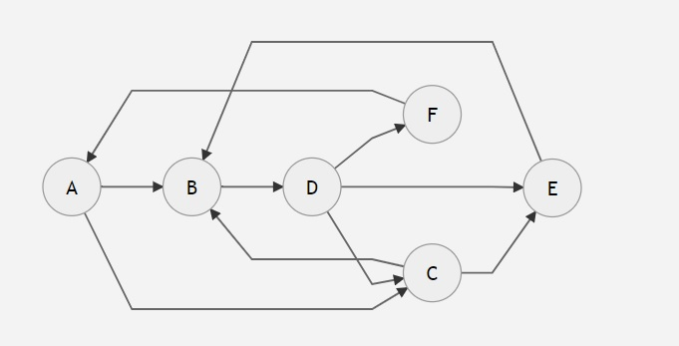
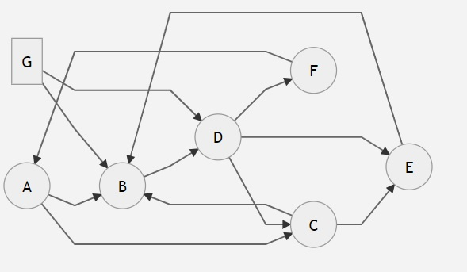
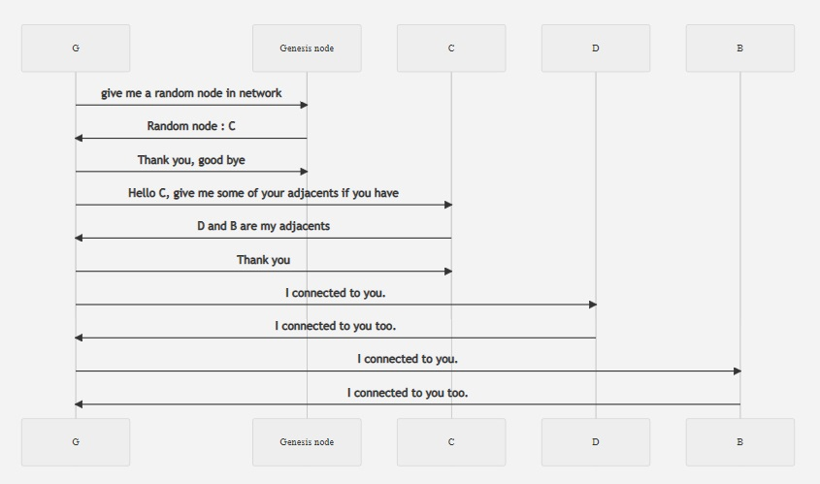
Peer-to-Peer Network Project...
https://github.com/siagianp
https://www.youtube.com/@AmelOline/videos
https://github.com/amelcharolinesgn2/IoT_simulator-mqtt-NodeRed
https://github.com/vnknt/p2p_network
https://github.com/amelcharolinesgn2/Cloud-Infrastructures
https://github.com/amelcharolinesgn2/ClouD-Infrastructure-SISKA-2025
https://github.com/amelcharolinesgn2/Gyroscope-Sensor-Data-Accelerometer
Notes:
https://github.com/Shengyuan-Li/CNN-for-Crack-Detection

Slide 9
Network-Transmision-simulator
UDP File Transfer: UdpStopWaitClient.jar and UdpStopWaitServer.jar
https://github.com/Arikatakur/Network-Transmission-Simulator
https://github.com/siagianp
https://github.com/Arikatakur/Network-Transmission-Simulator
https://github.com/trunk96/wireless-network-simulator
https://github.com/trunk96/wireless-network-simulator-v2
https://www.youtube.com/@AmelOline/videos
https://github.com/amelcharolinesgn2/IoT_simulator-mqtt-NodeRed
https://github.com/amelcharolinesgn2/Cloud-Infrastructures
https://github.com/amelcharolinesgn2/ClouD-Infrastructure-SISKA-2025
https://github.com/amelcharolinesgn2/Gyroscope-Sensor-Data-Accelerometer
Notes:
https://github.com/Shengyuan-Li/CNN-for-Crack-Detection

Slide 10
wireless-network-simulator: 4G/5G ...
4G/5G/Satellite Wireless Network Simulator
https://github.com/siagianp
https://www.youtube.com/@AmelOline/videos
https://github.com/amelcharolinesgn2/IoT_simulator-mqtt-NodeRed
https://github.com/trunk96/wireless-network-simulator
https://github.com/trunk96/wireless-network-simulator-v2
https://github.com/amelcharolinesgn2/Cloud-Infrastructures
https://github.com/amelcharolinesgn2/ClouD-Infrastructure-SISKA-2025
https://github.com/amelcharolinesgn2/Gyroscope-Sensor-Data-Accelerometer
Notes:
https://github.com/Shengyuan-Li/CNN-for-Crack-Detection

Slide 11
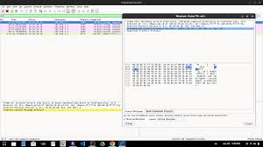
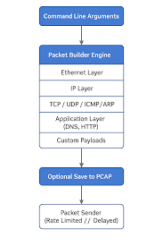
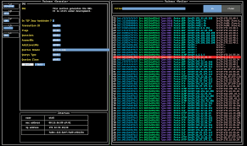
Network Packet Transmission Simulator...
https://github.com/siagianp
https://github.com/aelshako/Network-Packet-Transmission-Simulator
https://www.youtube.com/@AmelOline/videos
https://github.com/amelcharolinesgn2/IoT_simulator-mqtt-NodeRed
https://github.com/amelcharolinesgn2/Cloud-Infrastructures
https://github.com/amelcharolinesgn2/ClouD-Infrastructure-SISKA-2025
https://github.com/amelcharolinesgn2/Gyroscope-Sensor-Data-Accelerometer
Notes:
https://github.com/Shengyuan-Li/CNN-for-Crack-Detection

Slide 12
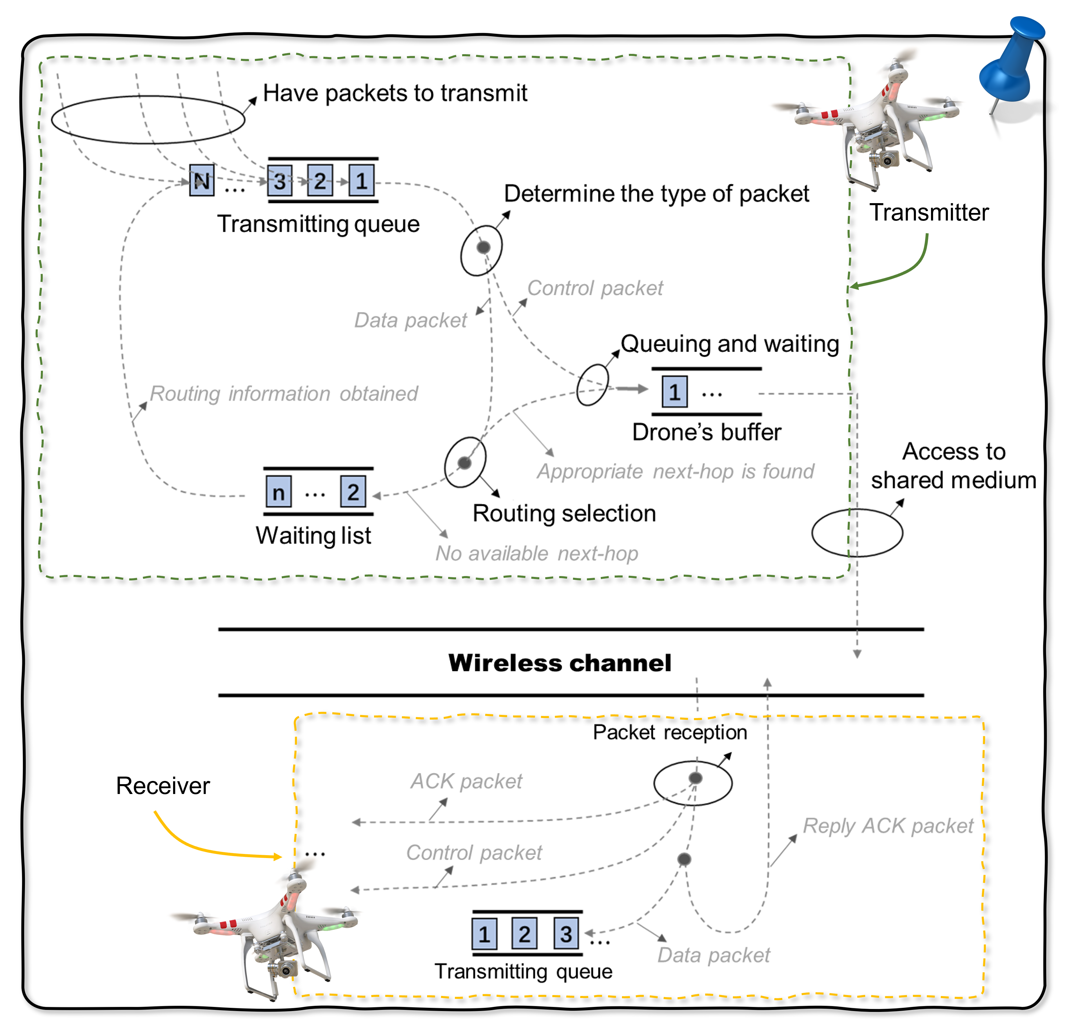
UavNetSim-v1: A Python based Simulation Platform for UAV Communication Networks ...
https://github.com/siagianp
https://www.youtube.com/@AmelOline/videos
https://github.com/amelcharolinesgn2/IoT_simulator-mqtt-NodeRed
https://github.com/Zihao-Felix-Zhou/UavNetSim-v1
https://github.com/amelcharolinesgn2/Cloud-Infrastructures
https://github.com/amelcharolinesgn2/ClouD-Infrastructure-SISKA-2025
https://github.com/amelcharolinesgn2/Gyroscope-Sensor-Data-Accelerometer
Notes:
https://github.com/Shengyuan-Li/CNN-for-Crack-Detection

Slide 13
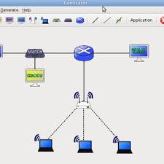
Qns-3: A Quantum Network Simulator Based on ns-3...
https://github.com/siagianp
https://www.youtube.com/@AmelOline/videos
https://github.com/amelcharolinesgn2/IoT_simulator-mqtt-NodeRed
https://github.com/cqs-thu/qns-3
https://github.com/amelcharolinesgn2/Cloud-Infrastructures
https://github.com/amelcharolinesgn2/ClouD-Infrastructure-SISKA-2025
https://github.com/amelcharolinesgn2/Gyroscope-Sensor-Data-Accelerometer
Notes:
https://github.com/Shengyuan-Li/CNN-for-Crack-Detection

Slide 14

Sama Simulator...
Python based simulator for 5G Radio Access Networks (RANs)
https://github.com/siagianp
https://www.youtube.com/@AmelOline/videos
https://github.com/amelcharolinesgn2/IoT_simulator-mqtt-NodeRed
https://github.com/cfragoas/Sama_simulator
https://github.com/amelcharolinesgn2/Cloud-Infrastructures
https://github.com/amelcharolinesgn2/ClouD-Infrastructure-SISKA-2025
https://github.com/amelcharolinesgn2/Gyroscope-Sensor-Data-Accelerometer
Notes:
https://github.com/Shengyuan-Li/CNN-for-Crack-Detection

Slide 15
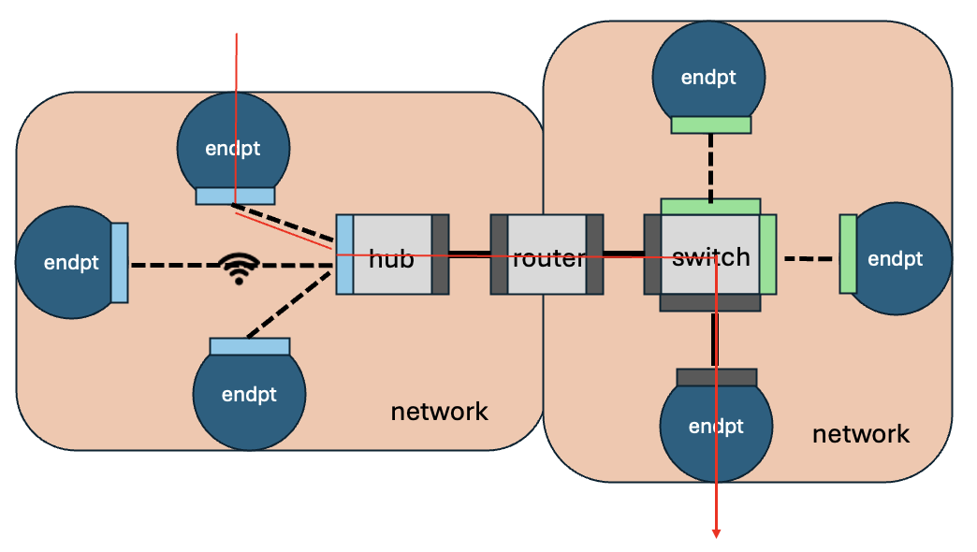
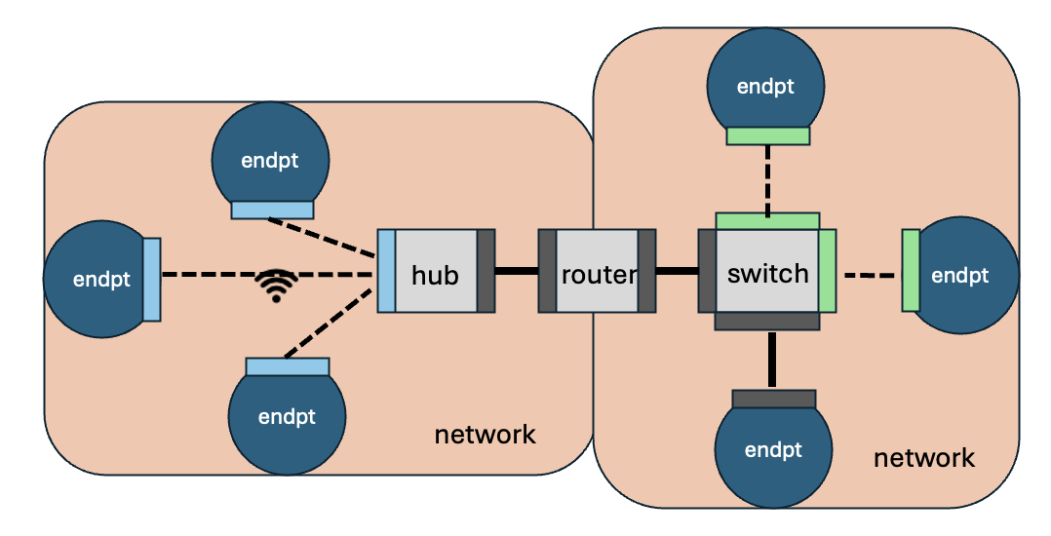
Multi-resolution network emulation-simulation...
https://github.com/siagianp
https://www.youtube.com/@AmelOline/videos
https://github.com/amelcharolinesgn2/IoT_simulator-mqtt-NodeRed
https://github.com/ITI/mrnes
https://github.com/amelcharolinesgn2/Cloud-Infrastructures
https://github.com/amelcharolinesgn2/ClouD-Infrastructure-SISKA-2025
https://github.com/amelcharolinesgn2/Gyroscope-Sensor-Data-Accelerometer
Notes:
https://github.com/Shengyuan-Li/CNN-for-Crack-Detection

Slide 16
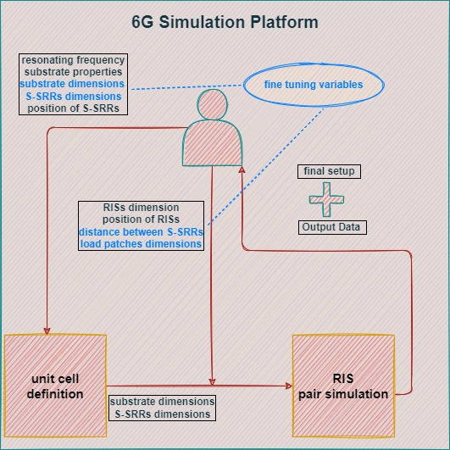
6G Simulation Platform: From the Physical-layer to Networking with RIS...
Physical Layer Simulation
https://github.com/siagianp
https://www.youtube.com/@AmelOline/videos
https://github.com/amelcharolinesgn2/IoT_simulator-mqtt-NodeRed
https://github.com/alexpapad95/6G-simulation-platform
https://github.com/amelcharolinesgn2/Cloud-Infrastructures
https://github.com/amelcharolinesgn2/ClouD-Infrastructure-SISKA-2025
https://github.com/amelcharolinesgn2/Gyroscope-Sensor-Data-Accelerometer
Notes:
https://github.com/Shengyuan-Li/CNN-for-Crack-Detection

Slide 17
Contoh Paper:
A Simulator for FANETs Using 5G Vehicle-to-Everything Communications and Named-Data Networking https://arxiv.org/html/2510.13823v1

Slide 18
Langkah yang akan dilakukan…..

Slide 19

Project ???? >>>
Summary : Paper reference and Run a Github
Title Paper : IoT Enhanced Deep Water Culture Hydroponic System for Optimizing Chinese Celery Yield and Economic Evaluation
Link :
Github : IoT Enhanced Deep Water Culture Hydroponic System for Optimizing Chinese Celery Yield and Economic Evaluation
Link :
Langkah Langkah Menjalankan
Dari judul tersebut. Uraikan Rumusan masalah, tujuan, Langkah-langkah yang dilakukan, Tahapan penelitian, Analisa hasil penelitian, research Gab, Relefansi teori yang digunakan, Github nya
Docx
Docx/pptx
Summary
What a News Gap ?
What are you purposed ?
You have Changes a Flow Process and Diagram ?
What are you purposed ?
Submit your Project on GD link
Title Paper_ Old :>> IoT Enhanced Deep Water Culture Hydroponic. Docx
IoT.Zip Old : >> Application and Step by step How to Run
Title Paper_ News :>> IoT Enhanced Deep Water Culture Hydroponic. docx
IoT.Zip a News : >> Application and Step by step How to Run
Persentation :>> IoT Enhanced Deep Water Culture Hydroponic.PPTX

Slide 20
Ex0: >>
IoT Enhanced Deep Water Culture Hydroponic System for Optimizing Chinese Celery Yield and Economic Evaluation
Latarbelakang:
Kebutuhan untuk meningkatkan hasil panen Chinese celery secara efisien.Ketergantungan pada kondisi lingkungan (suhu, cahaya) yang fluktuatif.Minimnya penerapan IoT dalam sistem hidroponik untuk tanaman ini secara spesifik.Rumusan masalah:Bagaimana sistem hidroponik DWC yang didukung oleh kontrol suhu dan pencahayaan berbasis IoT dapat meningkatkan hasil panen dan efisiensi ekonomi dalam budidaya Chinese celery?
Langkah-langkah Penelitian:
Desain sistem kontrol berbasis mikrokontroler ESP32 dan sensor suhu, kelembapan, pH, dan EC.
Desain empat kondisi perlakuan:
Kontrol suhu + cahaya
Hanya kontrol suhu
Hanya kontrol cahaya
Tanpa kontrol (alami)
Instalasi dalam 4 greenhouse DWC.
Penanaman Chinese celery selama 45 hari.
Monitoring otomatis melalui platform IoT (Blynk).
Analisis hasil pertumbuhan dan performa ekonomi.
Tahapan Penelitian:
Perencanaan sistem: Identifikasi kebutuhan sensor, aktuator, dan mikrokontroler.
Implementasi perangkat keras dan lunak: Integrasi sensor EC, pH, DHT (temperature & humidity), kontrol LED, pompa air, dan sistem misting.
Instalasi di lapangan: 4 greenhouse dengan perlakuan berbeda.
Pengumpulan data: Berat tanaman, tinggi tanaman, suhu, kelembapan, pencahayaan, setiap 5–7 hari.
Analisis data: Uji statistik (uji Friedman).
Evaluasi ekonomi: ROI, net profit, payback period.
Tujuan:
Menerapkan sistem kontrol suhu dan cahaya otomatis berbasis IoT dalam metode hidroponik DWC.Menganalisis pengaruh kombinasi kontrol tersebut terhadap pertumbuhan Chinese celery.Melakukan evaluasi ekonomi terhadap sistem IoT-enhanced dibandingkan sistem konvensional.

Slide 21
Ex0: >>
IoT Enhanced Deep Water Culture Hydroponic System for Optimizing Chinese Celery Yield and Economic Evaluation
Analisa Hasil:
Perlakuan kombinasi kontrol suhu dan cahaya menghasilkan hasil tertinggi (30,3 kg), dibandingkan kontrol alami (26,6 kg).
Kontrol suhu lebih signifikan terhadap pertumbuhan dibandingkan pencahayaan.
ROI terbaik justru pada sistem sederhana (tanpa kontrol), karena biaya awal lebih rendah, meskipun hasilnya sedikit lebih kecil.
Sistem IoT cocok untuk jangka panjang dan skala komersial.
Peningkatan efisiensi hingga 13,9% dari segi hasil panen.
Research Gap:
Penelitian sebelumnya banyak fokus pada tanaman lain, atau hanya satu variabel lingkungan (misalnya hanya suhu atau hanya cahaya).
Belum banyak kajian yang:
Mengombinasikan kontrol suhu + cahaya secara simultan.
Menerapkan analisis ekonomi secara mendalam.
Menggunakan sistem DWC (Deep Water Culture) yang dikontrol secara penuh dengan IoT untuk tanaman Chinese celery.
Github :
ESP32Sensor pH, EC, DHTSoftware kontrol via BlynkKode berbasis Arduino IDE
Referensi GitHub / kode
Hydruino (GitHub: NachtRaveVL/Simple‑Hydroponics‑Arduino) — controller hidroponik DIY berbasis Arduino/ESP32 yang mendukung sensor pH & EC. GitHub
SOIL_INTEGRATED_Sensor_NPK‑PH‑MOISTURE‑EC_InterfaceESP32 (GitHub: VinhCao09) — kode untuk sensor gabungan NPK, pH, EC, kelembapan berbasis ESP32. GitHub
PlantMonitoringSystem (GitHub: Shishir3D) — proyek monitoring tanaman dengan ESP32 + Blynk, walaupun fokus utama soil/kelembapan, bisa dikembangkan ke hidroponik. GitHub
Artikel “Design of a smart hydroponics monitoring system using ESP32 and the Internet of Things” — memberikan desain dan data nyata untuk sistem hidroponik yang termonitor pH, EC, suhu. PMC
Skripsi “Rancang Bangun Sistem Kontrol Nutrisi Tanaman Hidroponik Berbasis IoT Dengan Blynk” — cocok sebagai acuan implementasi aplikasi Android + ESP32 + sensor pH/TDS. UMS ETD-db
Rekomendasi langkah adaptasiPilih board ESP32 (misalnya ESP32‑DevKit) sebagai mikrokontroler utama.Integrasikan sensor:pH probe (air larutan hidroponik)EC/TDS sensor (untuk mengukur konsentrasi nutrisi)Suhu & kelembapan udara (DHT22 atau sensor alternatif)Suhu air (misalnya DS18B20)Sensor cahaya (optional, buat kontrol LED atau pencahayaan)Koneksi ke internet via WiFi; gunakan Blynk untuk antarmuka mobile: menampilkan data real‑time, menerima kontrol (misalnya pompa nutrisi, LED grow, pengudaraan).Scripting: baca sensor secara berkala, kirim ke Blynk; jika kondisi melewati threshold → aktifkan aktuator (pompa pengatur pH, pompa nutrisi, fan, lampu).Kalibrasi sensor pH/EC dan buat log historis untuk analisis.Simpan data (opsional) ke cloud atau server lokal untuk dataset dan analisis lebih lanjut.Dokumentasi kode di GitHub sendiri: README, wiring diagram, kode, library yang dipakai, petunjuk instalasi.

Slide 22
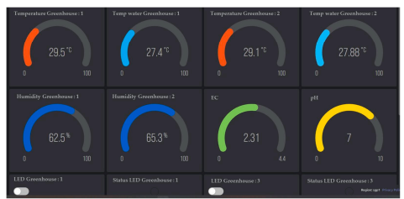
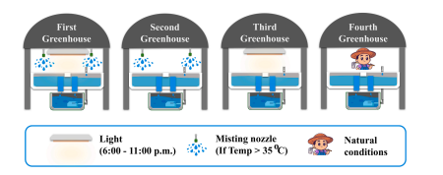
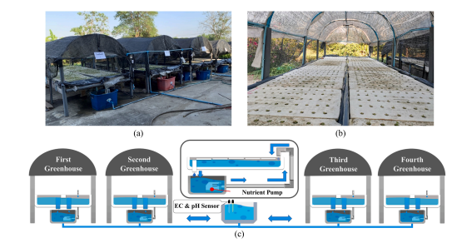
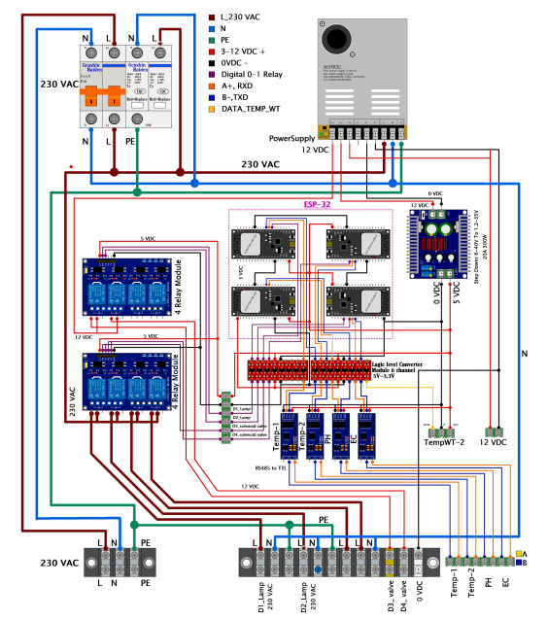
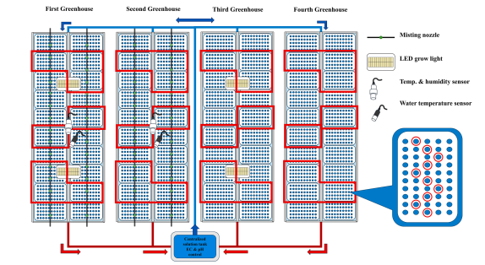
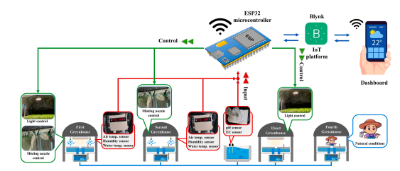
Ex0: >>
IoT Enhanced Deep Water Culture Hydroponic System for Optimizing Chinese Celery Yield and Economic Evaluation
3. Materials and methods
3.1. Hydroponic system components and IoT equipment
Fig. 3. Blynk IoT dashboard for data display and system management
Fig. 6. Experimental setup of four greenhouses with varied environmental controls to study celery growth.
Fig. 1. Greenhouse structure and hydroponic system for Chinese celery cultivation: (a) Open-structure greenhouse (b) Foam tray planting system (c) Schematic of
water circulation system and inter-greenhouse connections.
Fig. 2. ESP32-based greenhouse control system using the Blynk IoT platform
Fig. 4. ESP32-based control circuit diagram.
Fig. 7. Celery sampling layout.

Slide 23
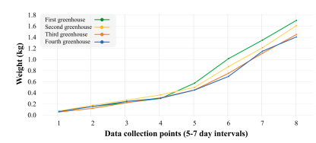
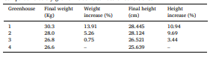
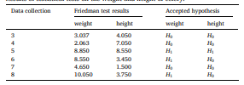
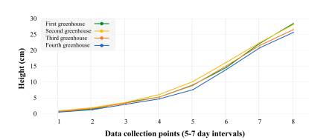
Ex0: >>
IoT Enhanced Deep Water Culture Hydroponic System for Optimizing Chinese Celery Yield and Economic Evaluation
Table 3 Comparative celery growth relative to natural conditions
Table 2 Results of statistical tests on the weight and height of celery
Fig. 8. Celery weight changes across four greenhouses over 40-45 day cultivation period
5. Conclusions
This study demonstrates significant progress in integrating IoT
technology with hydroponic farming systems, particularly for Chinese celery production. The findings reveal that environmental control using technology can significantly enhance both crop quality and quantity, with the greenhouse managing both temperature and extended light duration showing a 13.91% increase in yield compared to natural conditions
Fig. 9. Celery height progression in different greenhouse conditions during 40-45 days growth cycle.

Slide 24
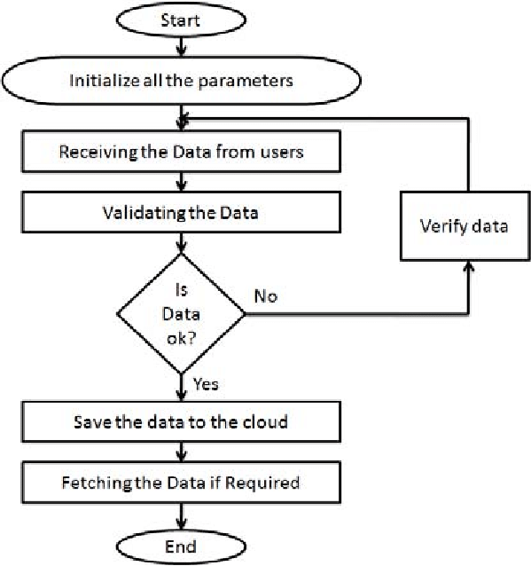
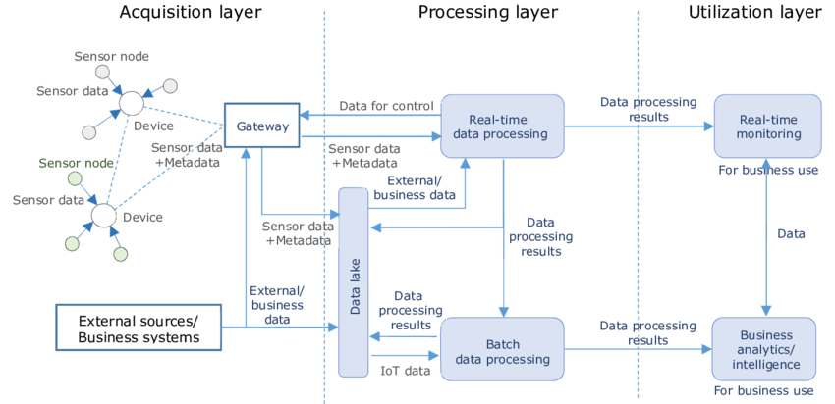
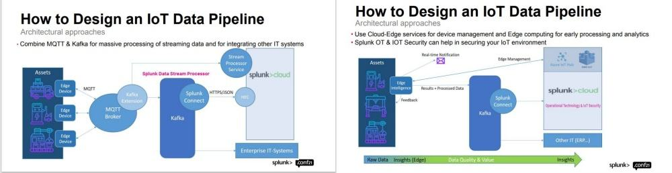
Ex0: >>
github simulation podman based IoT data sensor flow diagram, visualisasi
Referensi :
PlantMonitoringSystem (GitHub: Shishir3D/PlantMonitoringSystem) — sistem monitoring tanaman berbasis ESP32 + sensor + Blynk. GitHub
Water‑Monitoring‐System (GitHub: vinitshahdeo/Water‑Monitoring‑System) — IoT monitoring level cairan + dashboard. GitHub
Smart‑Irrigation‑System‑Using‑IoT (GitHub: polarao/Smart‑Irrigation‑System‑Using‑IOT‑Based‑On‑Temperature‑And‑Moisture‑In‑Soil) — sistem sederhana sensor kelembapan dan suhu untuk irigasi otomatis. GitHub
A. Automation System
Deskripsi:Sensor (pH, EC, suhu, kelembapan) mengumpulkan data di lapanganMikrokontroler (misalnya ESP32) mengirimkan data via WiFi/MQTT/HTTP ke broker atau serverBroker/message queue (MQTT, Kafka) menerima dan menyalurkan dataBackend penyimpanan (time‑series DB seperti InfluxDB, relasional, atau data lake)Visualisasi/dashboard (Grafana, ThingsBoard, web UI)(Opsional) Aktuator: berdasarkan data, trigger pump, lampu, kipas

Slide 25
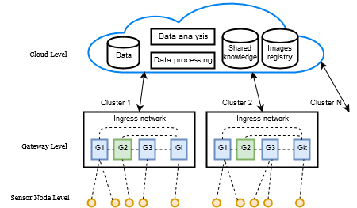
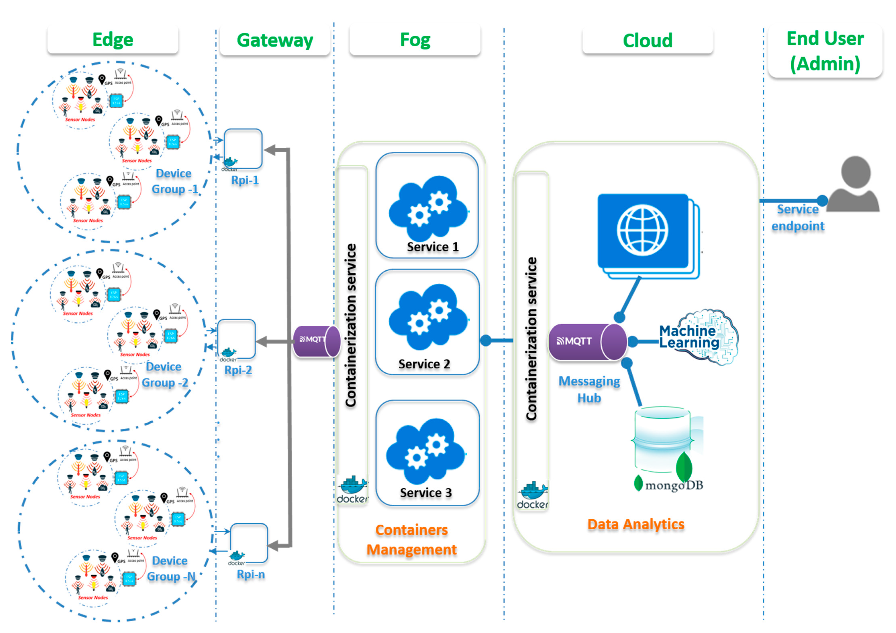
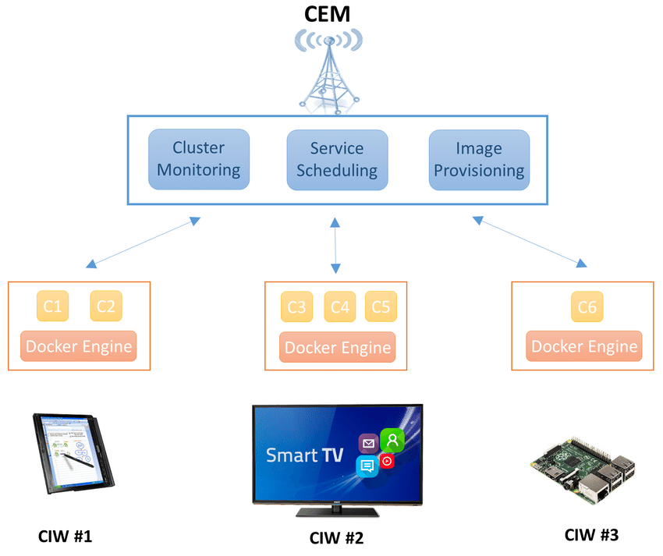
Ex1: >>
github simulation podman based IoT data sensor flow diagram, visualisasi
B. Sistem‑diagram kontainerisasi dengan Podman
Deskripsi komponen:
Edge layer: node sensor + ESP32 + lokal aggregator (misalnya gateway Raspberry Pi)
Container layer (di gateway atau server):
Container untuk MQTT broker (mosquitto)
Container untuk data ingestion service (misalnya Python Flask/Node.js)
Container untuk database (InfluxDB / PostgreSQL)
Container untuk visualisasi/dashboard (Grafana / ThingsBoard)
Cloud/Server layer: skalabilitas, remote access, backup, analytics
Penggunaan Podman: container runtime sebagai alternatif Docker, bisa deploy di server lokal.
Struktur Project GitHub
/iot‑hydroponic/
├─ /edge_gateway/
│ README.md
│ Dockerfile (atau Podman build file)
│ docker‑compose.yml (atau podman‑compose.yml)
│ /services/
│ mqtt_broker/
│ ingestion_service/
│ database/
│ dashboard/
├─ /sensor_node/
│ code_esp32/
│ main.ino
│ config.h
│ wiring_diagram.png
│
├─ /docs/
│ system_diagram.png
│ data_flow_diagram.png
│ deployment_guide.md
│
└─ README.md

Slide 26
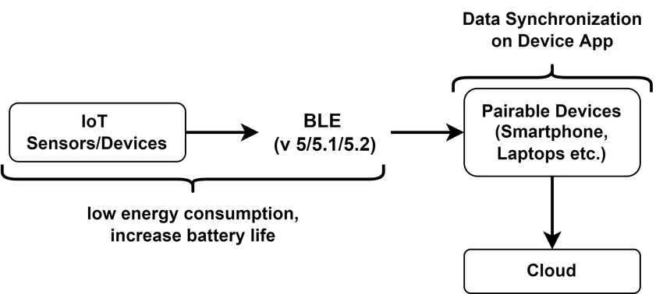
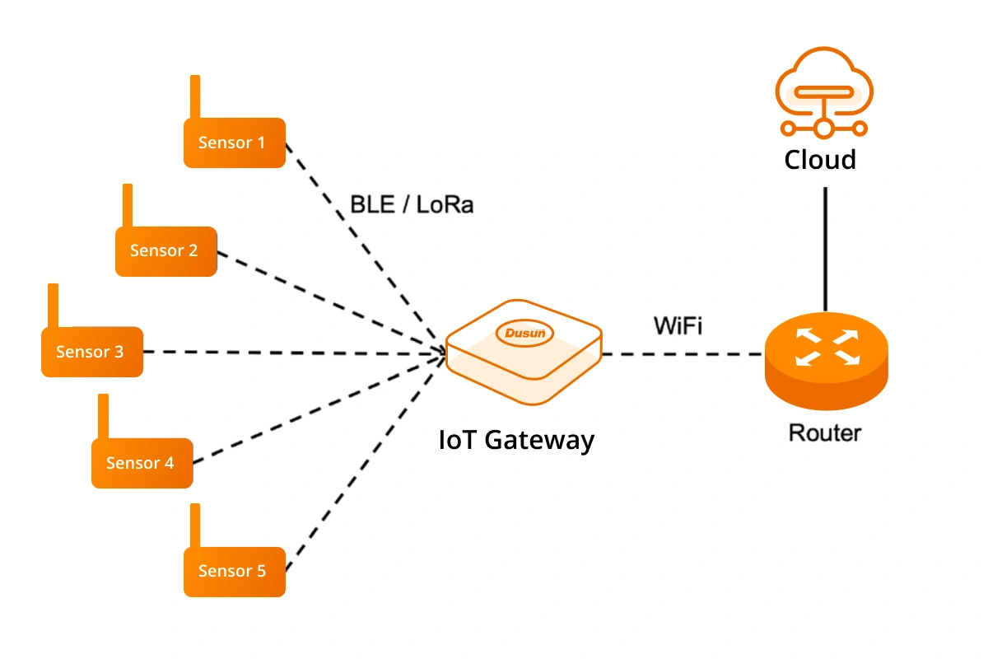
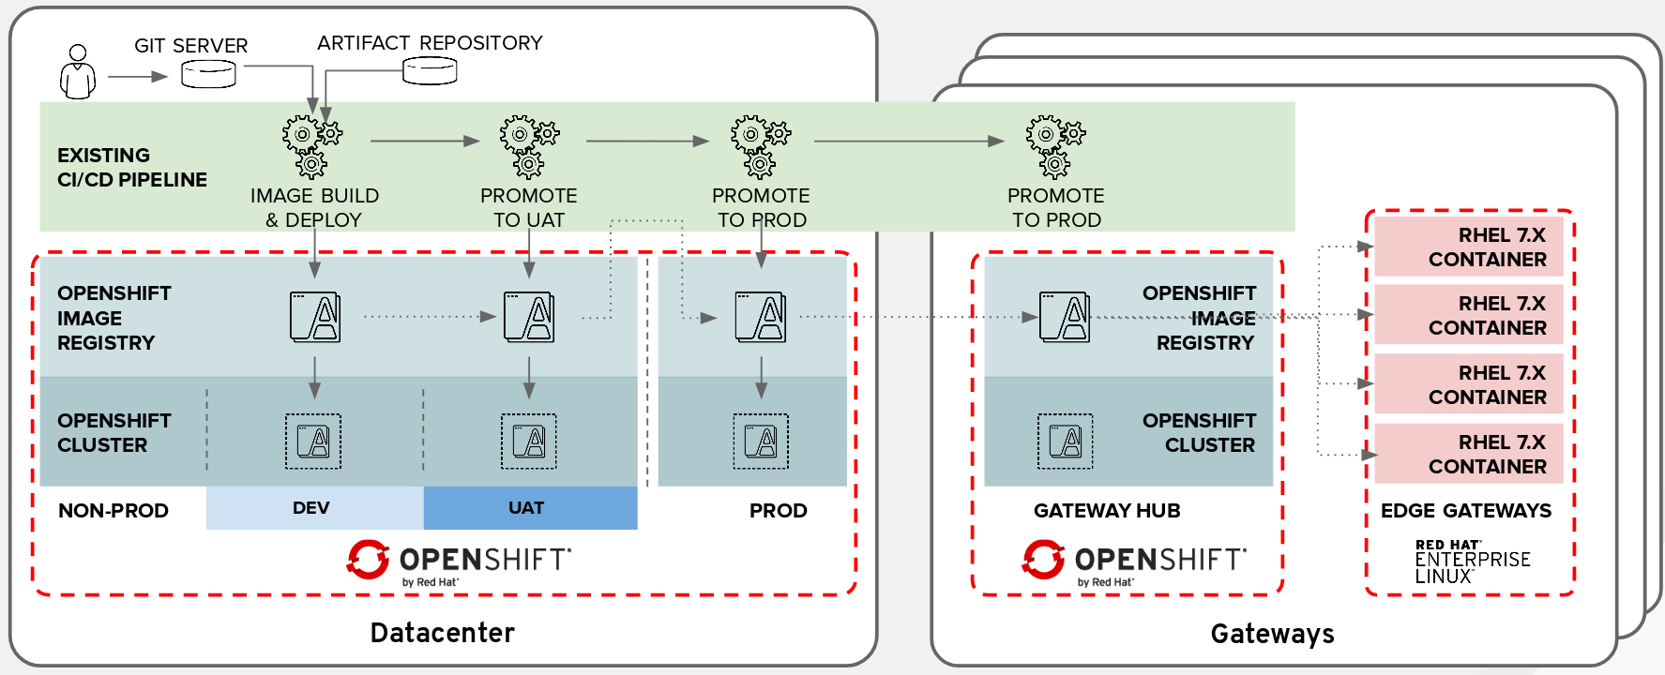
Ex1: >>
C. Monitoring
PlantMonitoringSystem (GitHub: Shishir3D/PlantMonitoringSystem) — sistem IoT monitoring tanaman (ESP32 + sensor kelembapan, suhu, kelembapan udara) yang punya dashboard mobile. GitHub
IOT‑Smart_Farming (GitHub: Deshan555/IOT‑Smart_Farming) — sistem pertanian pintar dengan berbagai sensor (cahaya, kelembapan, suhu, kelembapan udara) dan otomatisasi irigasi. GitHub
IOT‑MQTT‑Dashboard‑for‑ESP32‑Plant‑Sensor (GitHub: alialaei1/IOT‑MQTT‑Dashboard‑for‑ESP32‑Plant‑Sensor) — dashboard berbasis Django + MQTT + ESP32 untuk monitoring kondisi lingkungan tanaman. github.jpy.wang

Slide 27
Ex1: >>
Struktur Flow
Struktur Sistem dengan Podman
Sensor node (misalnya ESP32 + pH/EC/suhu/kelembapan) mengumpulkan data.
Data dikirim ke gateway/edge (misalnya Raspberry Pi atau mini‑server) via WiFi/MQTT/HTTP.
Di gateway: dijalankan layanan kontainer (menggunakan Podman) seperti broker MQTT, ingestion service (Python/NodeJS), database (InfluxDB atau PostgreSQL), dan dashboard (Grafana/ThingsBoard).
Dashboard menampilkan visualisasi realtime + historis, pengguna bisa mengontrol aktuator (pompa nutrisi, lampu LED grow, fan) dari situ.
(Opsional) Data juga dikirim ke cloud untuk backup/analitik lanjutan.
Setiap komponen dijalankan sebagai container:mqtt‑broker containerdata‑ingestor containerdatabase containerdashboard container
Podman menjalankan container (bisa rootless) dan/atau pods sehingga mudah deploy di server lokal atau edge gateway.
Struktur folder repository bisa seperti:
/edge_gateway/
podman-compose.yml Dockerfile‑ingestor configs/
/sensor_node/
firmware_esp32/
/docs/
system_diagram.png data_flow_diagram.png
README menjelaskan komponen, cara build & deploy dengan Podman, wiring diagram sensor.

Slide 28
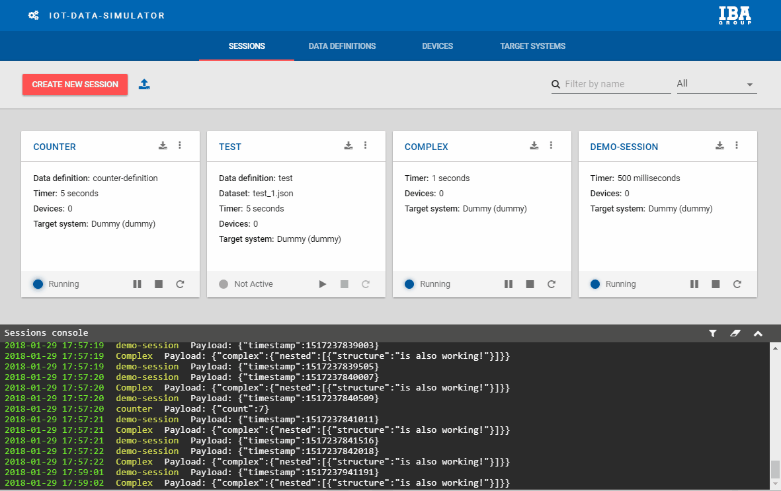
Ex2: >>
IoT-data-simulator
https://github.com/IBA-Group-IT/IoT-data-simulator?tab=readme-ov-file
Simulator features that you will like:
Replay existing datasets with modified data (such as updated timestamps, generated ids etc);
Automatic derivation of dataset structure which allows you to customize your dataset without the need to describe its structure from scratch;
Generate datasets of any complexity. Generated data can be described via constructor or JavaScript function. Multiple rules are available in constructor such as "Random integer", "UUID" and others. JS function gives you maximum flexibility to generate data - it supports popular JS libraries lodash and momentjs.
Send data to the platforms you use with minimum configuration (see Supported target systems section);
Customize frequency with which data will be sent - based on dataset timestamp properties or just constant time interval. The tool also supports relative timestamp properties which depend on other timestamp or date properties. It means that data can be replayed with the same interval between timestamps as in initial dataset.
Easy installation - all you need is to download 2 docker files and run 2 commands.
branding

Slide 29
Ex3: >>
IoT-Podman-simulator
https://github.com/jdbranham/grafana-diagram
https://github.com/MarkhamLee/internet-and-iot-data-platform
https://github.com/aws-solutions/iot-device-simulator
https://github.com/KrishArul26/IoT-Based-Remote-Sensor-Data-Monitoring-and-Actuator-Control
https://blog.devops.dev/how-i-built-a-smart-home-monitoring-system-with-mqtt-go-prometheus-and-grafana-1fd91521baf8
https://github.com/Nilhcem/home-monitoring-grafana
IoT data monitoring with MQTT, InfluxDB and Grafana
https://github.com/jdbranham/grafana-diagram
https://github.com/iothon/docker-compose-mqtt-influxdb-grafana
https://mpolinowski.github.io/docs/DevOps/Provisioning/2019-01-08--creating-a-grafana-dashboard/2019-01-08/
https://github.com/TouradBaba/sensors_data_streaming

Slide 30
Thank you!
PDS
Computer Vision
Thank you For being a great class!
https://github.com/siagianp
https://www.youtube.com/@AmelOline/videos
https://github.com/amelcharolinesgn2/IoT_simulator-mqtt-NodeRed
https://github.com/amelcharolinesgn2/Cloud-Infrastructures
https://github.com/amelcharolinesgn2/ClouD-Infrastructure-SISKA-2025

